Slide 1
How to make bumper video openSUSE using Inkscape and synfig
Muhammad Irfan
Irfan.pule2@gmail.com

Slide 2
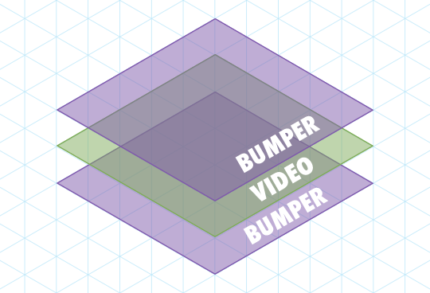
What is video bumper ?
In the United Kingdom, a break-bumper is a brief appearance of a logo before or after advertising breaks, usually that of the television channel being watched.
https://en.wikipedia.org/wiki/Bumper_(broadcasting)

Slide 3
What is video bumper ?
Bumper videos can be used for opening and closing video
Tutorial
Presentation
Teaser
Review
etc

Slide 4




How to make it ?
Save As
Render
Inkscape Project
.svg
Synfig Project
.sif or .sifz
Bumper Video
.mp4

Slide 5
Inkscape Project
Setting Document project to 1280 x 720.
it is same HD 720p on project video editing software

Slide 6
Inkscape Project
Create a design according to your imagination
Then create layers according to the objects that will be animated.
automatically after a save as to Synfig will create the same layer

Slide 7
Inkscape Project
SS project ada layer di kanan
automatically after a save as to Synfig will create the same layer

Slide 8
Inkscape Project
Save as to .sif file
.sif file is Synfig file extention

